Slide 1
Stochastic simulation & derivatives risk engine
August 19, 2026
Berkeley Haas MFE Industry Project | Kickoff

Slide 2
Who is Capitolis
Creating safer capital markets
The challenge
  Financial institutions need to continuously optimize financial resources to serve clients, support growth, and produce shareholder value.
  Increasing regulatory demands on capital and liquidity drive the need for innovative solutions.
Two means to address the challenge
  Capital Marketplace: Identify and access new pools of capital from institutional investors to support the provision of core financial services by banks in a safe and efficient manner. Capitolis has multiple product offerings including a product that is an SEC-registered broker-dealer and securities-based swap dealer (SBSD) with an OTC derivatives trading desk.
  Portfolio Optimization: Optimize the existing portfolio without changing market risk by reducing or novating positions through compression or other optimization exercises with multiple counterparties.

Slide 3
Capital Marketplace and Efficient Swap Financing
Bringing banks and investors together on a single platform
Capital Marketplace
Live with 18 bank clients, 70+ investors, and $35.4B in assets on platform. Products span Efficient Swap Financing (ESF), Unsecured Bond Borrow, Securities Financing Platform, and Counterparty Risk Financing.
Efficient Swap Financing (ESF)
A platform providing balance sheet efficiencies to bank Total Return Swap (TRS) and other derivative counterparties by uniquely uniting funded investors and banks.
Transforms illiquid bilateral transactions into liquid CUSIP instruments, providing banks with derivative capacity uncorrelated to traditional markets.
Why ESF drives our risk work
ESF creates a portfolio of OTC derivative positions (equity and bond TRS, bond forwards, etc.) that must be priced, risk-managed, and capitalized. This is the portfolio you will be simulating in this project.

Slide 4
The Capitolis team
We are your professional supervisors
Jed Serby
Director, Model Risk
I serve as the lead for quantitative analytics and internal model development within the Risk department here at Capitolis, supporting both Capital Marketplace and Portfolio Optimization products.
Prior to joining Capitolis in November 2025, I led a commercial credit risk model development team at CapitalOne in New York. Prior to this, I served as the Head of Model Development Quality Assurance at U.S. Bank, and as a quantitative consultant at Promontory Financial Group.
I hold an MFE from Berkeley, an MA in actuarial science from Columbia University, and a B.A. in Economics and Mathematics from Emory University.
Frank Butler
Senior Risk Specialist
I provide quantitative support focused on model development and validation within the Risk Department for the Capital Marketplace.
I bring nearly 35 years of financial services experience to the Firm, most recently serving as a Managing Director at FMS Wertmanagement Service GmbH, where I developed new financial products. Prior to this, I held senior quantitative analytics roles at HypoVereinsbank, Barclays Bank, and Fuji Capital Markets. Before entering the financial services industry, I worked as a staff physicist at the IBM T.J. Watson Research Center, performing supercomputing calculations of the properties of hadronic matter.
I hold a Ph.D. in theoretical physics from Columbia University and an A.B. in physics from the University of Chicago.
Paul Tatulea
Algo Engineer
I've spent the past seven years working on risk and optimization engines for portfolio optimization. My work spans rates derivatives (interest rate swaps, cross-currency swaps, swaptions, cap/floors, and CMS spread options), FX products (forwards and options), and credit products (credit default swaps), with a focus on risk sensitivities, XVA, and regulatory capital frameworks like SIMM and SA-CCR. Across the industry, the products I work on have compressed trillions of dollars in notional and delivered billions in initial margin savings. I am passionate about financial markets, derivatives pricing and risk, and scaling systems for high throughput and reliability. But most of all, I enjoy learning from and working with similarly passionate people.

Slide 5
Project objectives
Build the computational backbone of a counterparty credit risk framework
Design and implement a modular Monte Carlo simulation engine capable of ingesting OTC derivative pricing models, market data, and cross-asset correlation structures.
1. Stochastic models
Implement risk factor models (your choice) and simulate correlated paths. You must be ready to defend your decisions.
2. Pricing model integration
Feed simulated market states into the provided pricing models to generate scenario NPVs.
3. Exposure and Greeks
Derive exposure profiles (PFE, MPE, EE) and efficient Greeks computation across scenarios. Extra Credit Opportunity: xVA
4. Performance
Optimize engine for speed and scalability. Using cutting edge techniques to make this fast.

Slide 6
Materials provided vs. your responsibilities
What Capitolis provides
16 trades across 4 instrument types for 3 counterparties:
8 Equity TRS (incl. 1 JPY compo trade)
4 Bond Forwards
4 Bond TRS
Underlying assets:
  41 underlying equity positions across baskets
  5 bond types
Risk factors per trade:
USD Equity TRS: USD curve + equity spots
JPY Compo TRS: USD curve + equity spots + USDJPY FX
Bond Fwd/TRS: USD curve only (risk-free bonds)
Capitolis is strictly seller on these transactions!
What you collect and build
Market data:
USD OIS (SOFR) curve
Equity spots and dividend rates per name
USDJPY FX spot and forward curve
Volatilities for all risk factors
Pairwise correlation matrix
See more requirements in the MARKET_DATA.md
The Risk Engine:
Stochastic models for rates, equity, FX
Correlated path simulation
Exposure aggregation by netting set, along with Greeks
Extra Credit: source and incorporate risky bonds in example trades

Slide 7
Pricing Models
We are providing a standalone Python pricing library for your use
Folder structure of the capitolis_pricers Zip File
trade_data/ Capitolis-supplied trade CSVs
trade_data/underlyings/ Reference assets for the trade mapping on equities (by trade_id) and bonds (by bond_id)
capitolis_pricers/ Pricing modules: equity_trs.py, bond_trs.py, bond_forward.py, plus curve and market builders
capitolis_pricers/examples/ price_all.py (runs full book)
Full documentation of every field, pricer contract, and data layer: README.md
The pricing model connection
Every pricer is a pure function of a MarketState.
To build exposure, your engine simulates risk factors, assembles a MarketState per (scenario, horizon) node, and calls pricer.npv(node_market).
This is the integration point between your simulation and the provided pricing models.

Slide 8
Exposure and PFE
What is exposure?
When a counterparty defaults on an OTC derivative, your exposure is the positive mark-to-market at that moment, net of collateral collected. Because you cannot know when default will occur or what rates and prices will be, monte carlo is one method to derive hypothetical market scenarios across time and measure the distribution of potential exposures at a given horizon.
Key exposure metrics: We require the 10-day close out windows over one year horizon.
Expected Exposure (EE): The mean of positive NPVs across scenarios over the 10-day close out window at each time step.
Potential Future Exposure (PFE): We require the 99th percentile for 10-day close out windows over one year horizon. This would be calculated by the 10-day period at a given time step for each time step in the one-year horizon.
Maximum PFE (MPE): The peak of the profile of 10-day PFEs across all time horizons.
Exposures are computed per trade and aggregated up to the counterparty level.

Slide 9
Key assumptions
Assume no initial margin.
Assume collected/posted variation margin on a given date in the simulation is the NPV of the trade on the prior day on the path. Because the counterparty defaults, variation margin discontinues over the close out period and exposure is how much it moves from the NPV on t-1.
Use a 10-day close out period. That means, assume it takes 10 days from default to close out the trade – what does the exposure grow to over that period? How you get 10-day windows and cover all days over the one-year horizon is up to you (interpolation?)
The number of simulations you incorporate is up to you but must evidence convergence
General rule of thumb: as we are strictly sellers on derivatives, falling market values increase counterparty exposure to us – should they default it is not recoverable – and thus higher PFEs and MPEs all else equal

Slide 10
Project timeline
August 19 - October 3 | ~7 weeks | Weekly check-ins
Stage | Description | Deliverables | Aug 24 | Aug 31 | Sept 7 | Sept 14 | Sept 21 | Sept 14 | Sept 28
Onboarding and Data Collection | Review provided pricers and trade data. Source market data (curves, spots, FX, dividends). Validate pricing against sample market. Set up GitHub repo and project structure. | GitHub Repo Data Pricers and trades (Capitolis)
Foundations Engine Buildout | Choose and implement stochastic models for rates, equity, FX. Build correlation proxy method from historical data. Stand up the full Monte Carlo engine with joint simulation of correlated risk factors. Integrate with provided pricers to generate scenario NPVs. Compute netting-set level exposure profiles. Demonstrate speed and performance | Risk Engine with outputs Benchmarks for speed Analytical benchmarks for accuracy
Analytics | Implement Greeks (bumped or pathwise) | Greeks
Documentation and final presentation | Finalize technical report with benchmarks. Presentation to Capitolis Risk department | Codebase in GitHub Technical report (details in appendix)
Extra credit options not put in swimlanes:
Risk bonds + CDS data for new sample trades
xVA outputs

Slide 11
Appendices

Slide 12
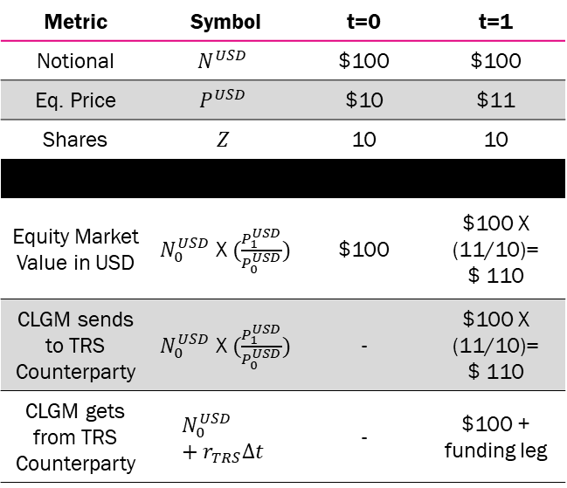
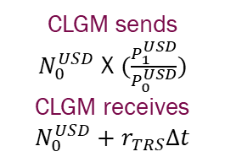
TRS: Passing on all gains for equities (and bonds!)
Example: Price ↑10%
TRS contract +
No economic exchange at t=0
Metric | Symbol | t=0 | t=1
Notional | $$N^{USD}$$ | $100 | $100
Eq. Price | $$P^{USD}$$ | $10 | $11
Shares | $$Z$$ | 10 | 10
Equity Market Value in USD | $N_{0}^{USD} \text{X}$ $(\frac{P_{1}^{USD}}{P_{0}^{USD}})$ | $100 | $100 X (11/10)= $ 110
CLGM sends to TRS Counterparty | $N_{0}^{USD} \text{X}$ $(\frac{P_{1}^{USD}}{P_{0}^{USD}})$ | - | $100 X (11/10)= $ 110
CLGM gets from TRS Counterparty | $$N_{0}^{USD}+r_{TRS}∆t$$ | - | $100 + funding leg
Capitolis
TRS Counterparty
CLGM sends
$N_{0}^{USD} \text{X}$ $(\frac{P_{1}^{USD}}{P_{0}^{USD}})$
CLGM receives
$$N_{0}^{USD}+r_{TRS}∆t$$
Includes immediate payment on the ex-date to the counterparty for all dividends (equities) and coupons (bonds)
Legend
Flow at t=0 Flow at t=1

Slide 13
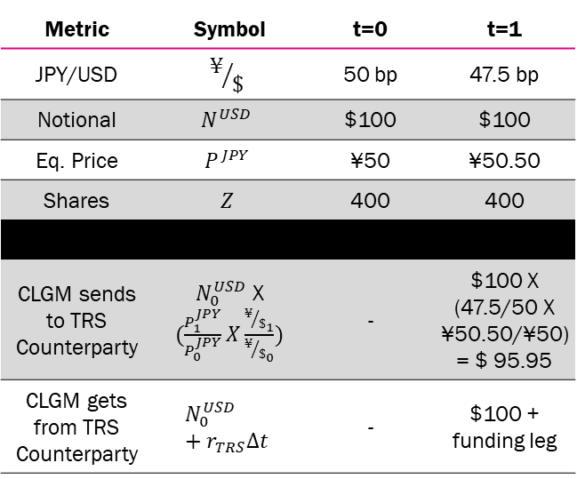
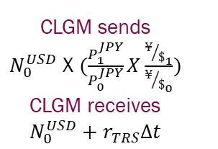
Compo: TRS Performance Leg in USD, Funding Leg in USD
Counterparty takes FX risk as return is a function of two risk factors
Example: Price ↑1% & JPY/USD ↓ 5%
Capitolis
TRS contract +
No economic exchange at t=0
TRS Counterparty
Metric | Symbol | t=0 | t=1
JPY/USD | $$¥/\$$$ | 50 bp | 47.5 bp
Notional | $$N^{USD}$$ | $100 | $100
Eq. Price | $$P^{JPY}$$ | ¥50 | ¥50.50
Shares | $$Z$$ | 400 | 400
CLGM sends to TRS Counterparty | $N_{0}^{USD} \text{X}$ $(\frac{P_{1}^{JPY}}{P_{0}^{JPY}}X\frac{{¥/\$}_{1}}{{¥/\$}_{0}})$ | - | $100 X (47.5/50 X ¥50.50/¥50) = $ 95.95
CLGM gets from TRS Counterparty | $$N_{0}^{USD}+r_{TRS}∆t$$ | - | $100 + funding leg
CLGM sends
$N_{0}^{USD} \text{X}$ $(\frac{P_{1}^{JPY}}{P_{0}^{JPY}}X\frac{{¥/\$}_{1}}{{¥/\$}_{0}})$
CLGM receives
$$N_{0}^{USD}+r_{TRS}∆t$$
Includes immediate payment on the ex-date to the counterparty for all dividends (equities) and coupons (bonds)
Legend
Flow at t=0 Flow at t=1

Slide 14
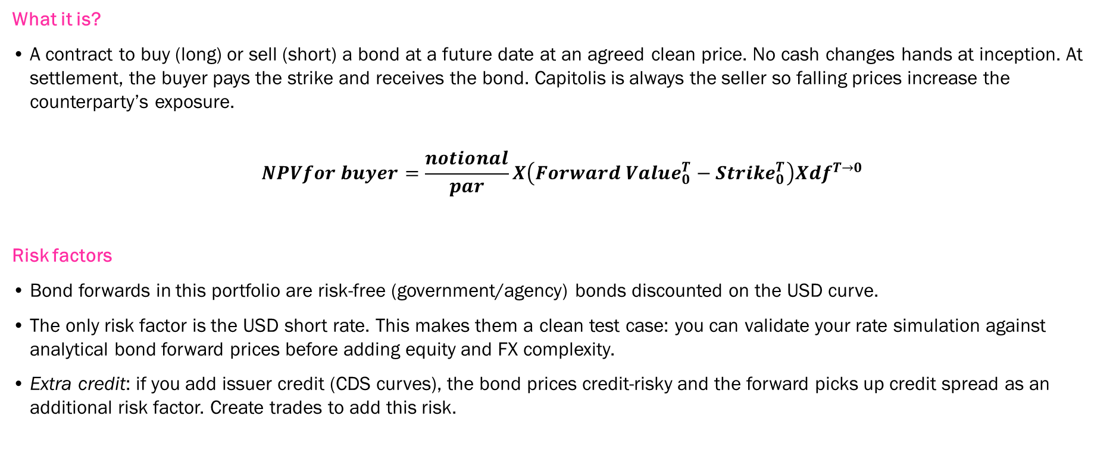
Bond forward: agreeing today on a future bond price
The least complex derivative in the portfolio as a function solely of interest rates
What it is?
A contract to buy (long) or sell (short) a bond at a future date at an agreed clean price. No cash changes hands at inception. At settlement, the buyer pays the strike and receives the bond. Capitolis is always the seller so falling prices increase the counterparty’s exposure.
$$NPVfor buyer=\frac{notional}{par}X\left({Forward Value}_{0}^{T}−{Strike}_{0}^{T}\right)X{df}^{T→0}$$
Risk factors
Bond forwards in this portfolio are risk-free (government/agency) bonds discounted on the USD curve.
The only risk factor is the USD short rate. This makes them a clean test case: you can validate your rate simulation against analytical bond forward prices before adding equity and FX complexity.
Extra credit: if you add issuer credit (CDS curves), the bond prices credit-risky and the forward picks up credit spread as an additional risk factor. Create trades to add this risk.

Slide 15
Exposure and Regulatory Requirements
The regulatory purpose of the engine you are building
SA-CCR and bank regulatory capital
SA-CCR (Standardized Approach for Counterparty Credit Risk) is the Basel III framework banks use to convert exposure into a capital charge:
Exposure at Default (EAD) = alpha x (Replacement Cost + PFE add-on).
Banks must hold capital against this EAD.
This is what drives demand for Capitolis products — CM helps banks optimize these capital charges.
SEC Rule 18a-1 for SBSDs
As a registered SBSD, Capitolis computes net capital under SEC Rule 18a-1.
Rule 18a-1 requires specific market risk and credit risk charges on OTC derivative positions.
Internal models that produce VaR and MPE feed directly into these capital computations.

Slide 16
Final Deliverable Descriptions
Simulation Engine Codebase
Well-documented Python implementation with modular architecture enabling extensions to additional asset classes or model types
Technical Report
Documentation of model calibration methodology against provided market data, with benchmarking of simulated prices against analytical solutions where available.
The paper should include technical write-up covering model choices, numerical methods, key results, and suggestions for production hardening.
The report should include performance analysis demonstrating computational capabilities, including convergence and optimization metrics

